Slide 1
Convolutional Neural Networks

Slide 2
Contents
Image processing in a nutshell
Example: lateral inhibition
Convolutional Neural Networks
The neocognitron

Slide 3
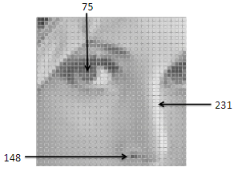
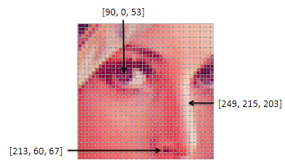
Images in computers
Matrix of integer values
Value ~ pixel brightness
Range: [0, 255]
Color
Grayscale
Color triplet [R, G, B]
As a function f(x,y):
f(x,y) is the pixel brightness at position (x,y)

Slide 4
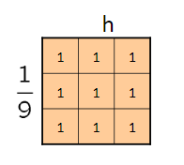

Image filtering
Create a new image G from image F using filter H
Filtering is accomplished by doing a convolution between a convolution matrix (kernel) h and the input image F

Slide 5
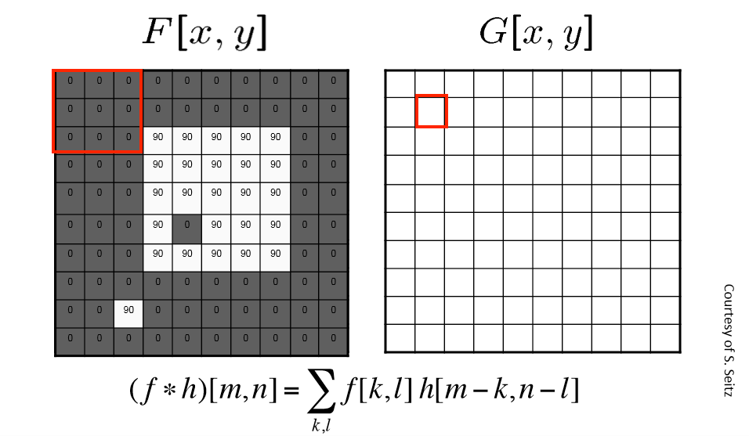

Slide 6
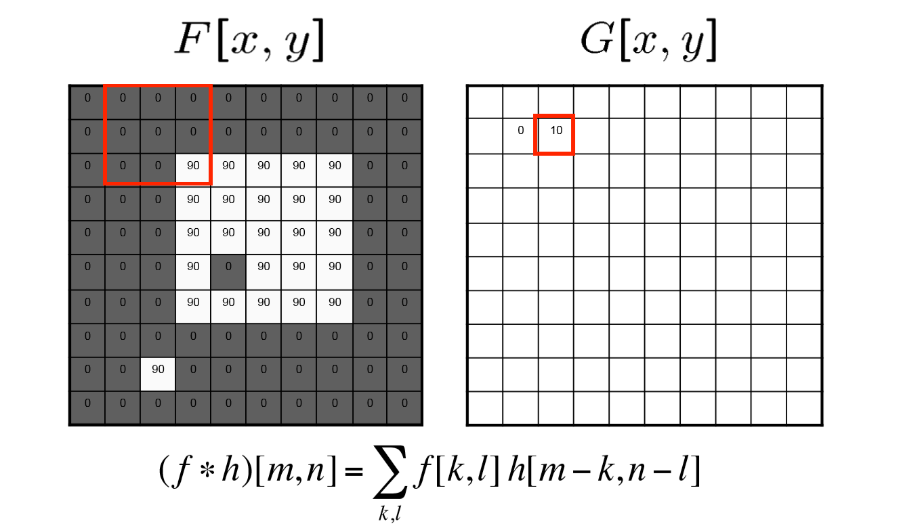

Slide 7
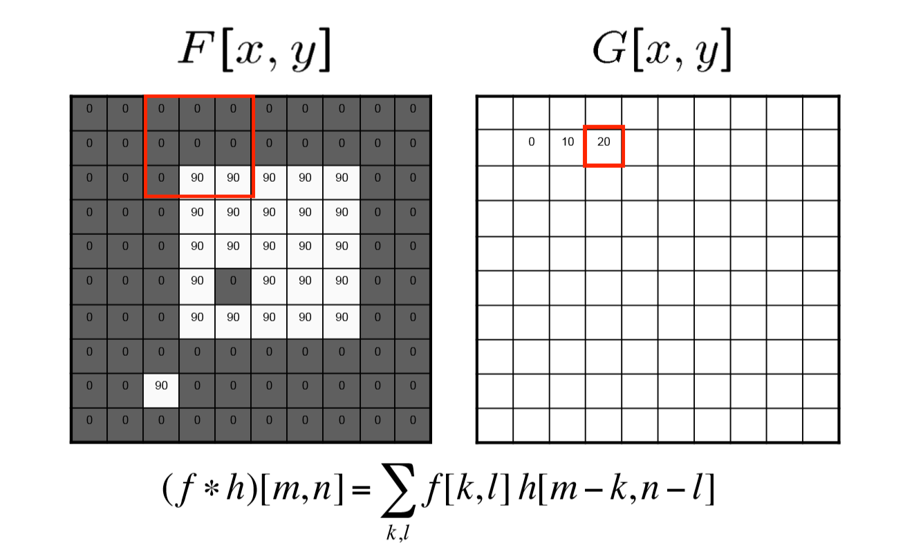

Slide 8
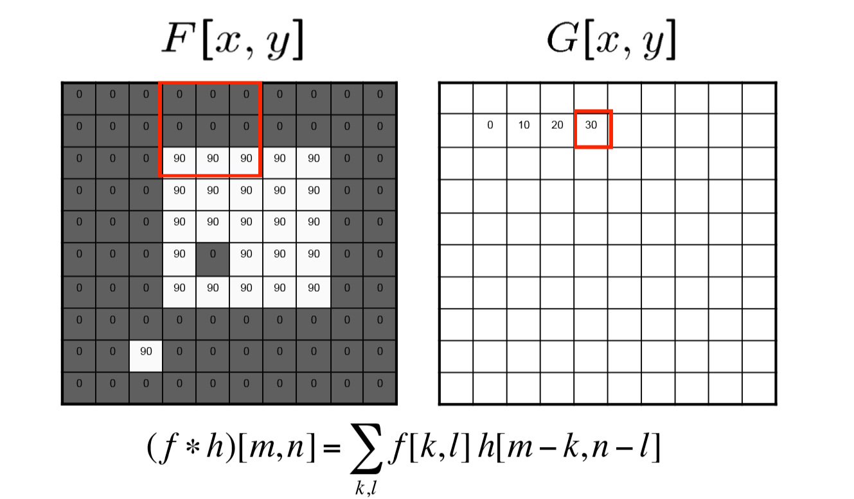

Slide 9
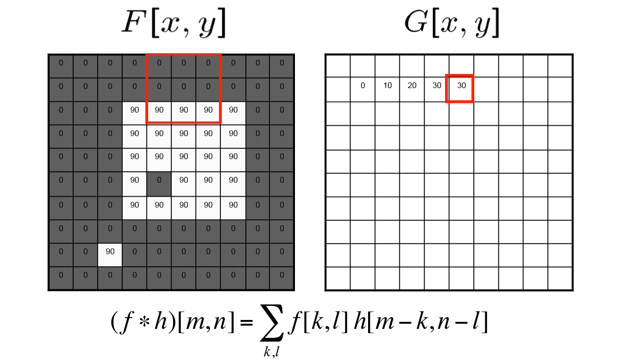

Slide 10
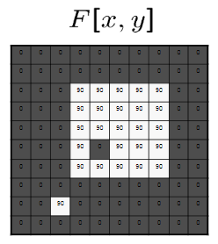
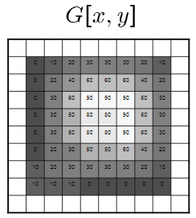
Summary

Slide 11
Example: lateral inhibition

Slide 12

HERMANN GRID
Hermann Ludimar (1870)
Focus on crossing
Effect will disappear
Effect only appears in peripheral vision
High density of cells in fovea

Slide 13
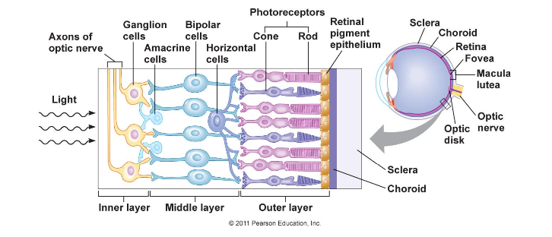
RETINA
Baumgartner (1960)
Ganglion cells
Lateral inhibition
Simplified model
Bipolar cells
Horizontal cells

Slide 14
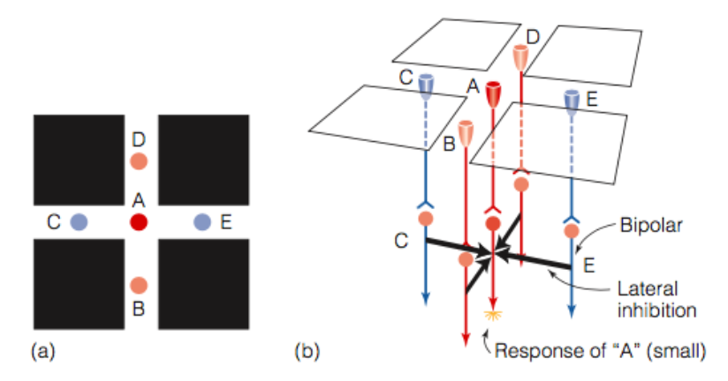
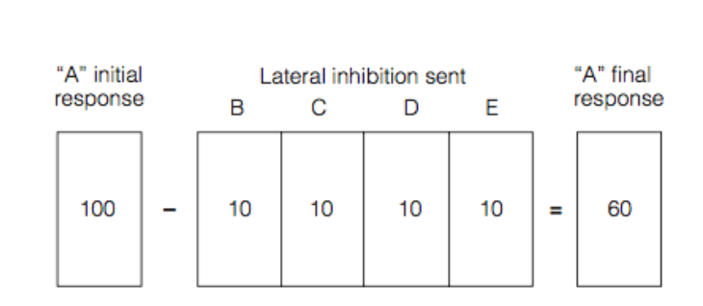
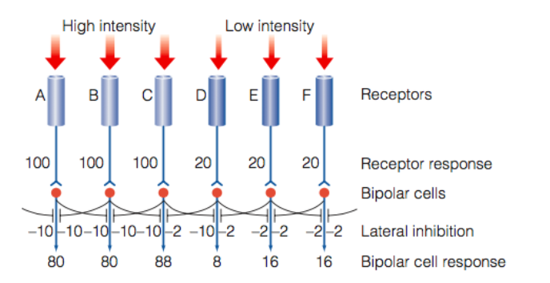
LATERAL INHIBITION
Activity of neighbouring neurons is reduced by an excited neuron
A new = A – (B • 0,10 + C • 0,10 + D •10 + E • 0,10)

Slide 15
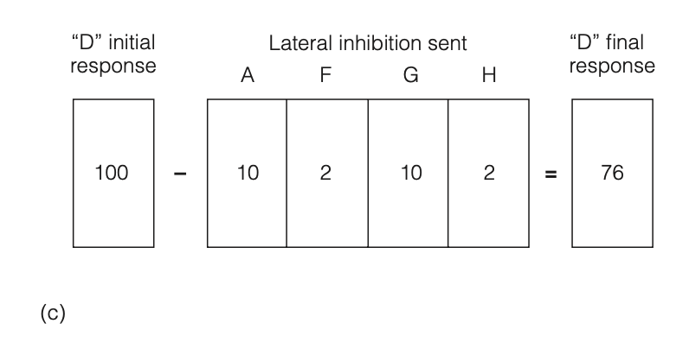
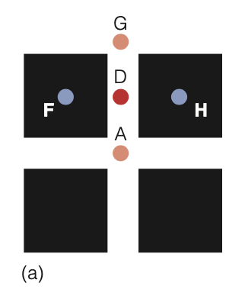
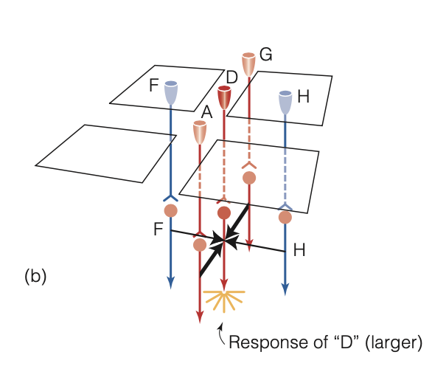
LATERAL INHIBITION
Purpose lateral inhibition is to enhance edges
Lighter colors will be perceived as lighter
Darker colors will be perceived as darker

Slide 16
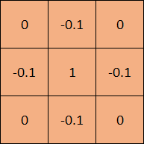
CONVOLUTION FILTER

Slide 17

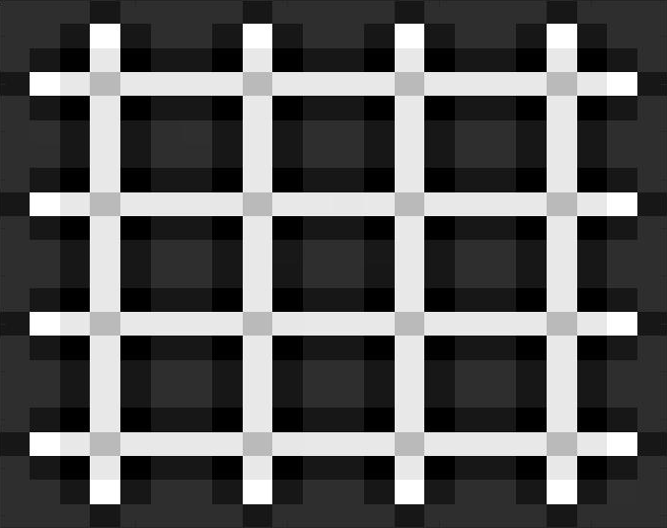
RESULT
∗ =

Slide 18
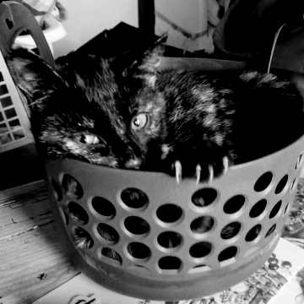

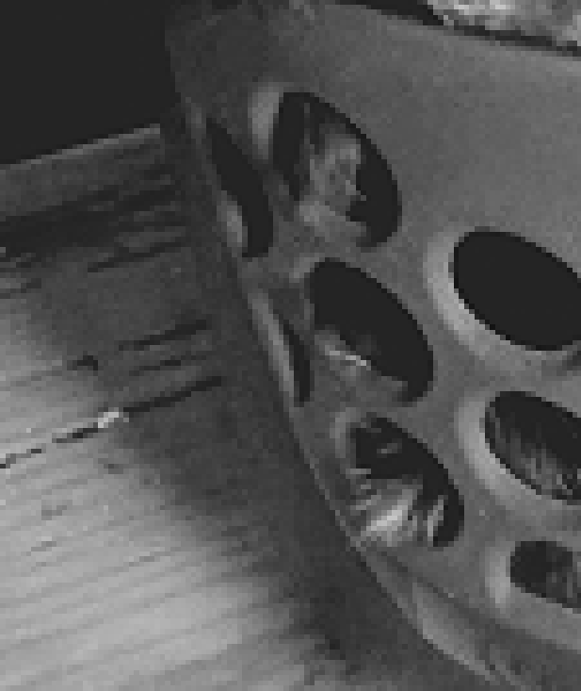
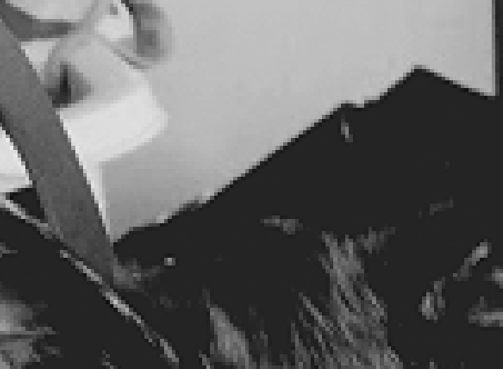
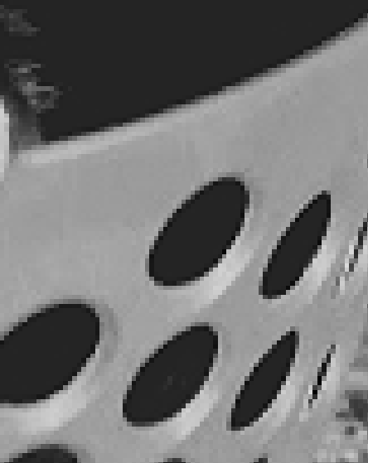
EDGE DETECTION
∗ =

Slide 19
Convolutional Neural Networks
We can build a convolutional neural network by adding more layers
Goal: feature extraction
Object recognition
Language processing
Medical image analysis
Econometrics
Notes:
Watch out when you enhance your image filter, it might become sentient.
Econometrics application: 10.1109/CBI.2017.23

Slide 20
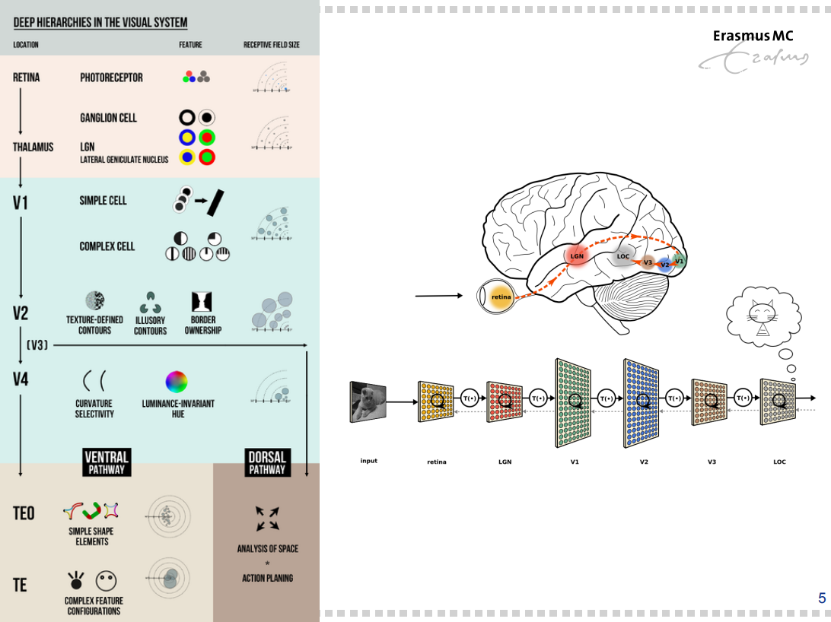
Notes:
I stole your slide :P. Might be a smoother transition so soon after the lateral inhibition story, before we dive into the techy details of convolutional neural networks

Slide 21
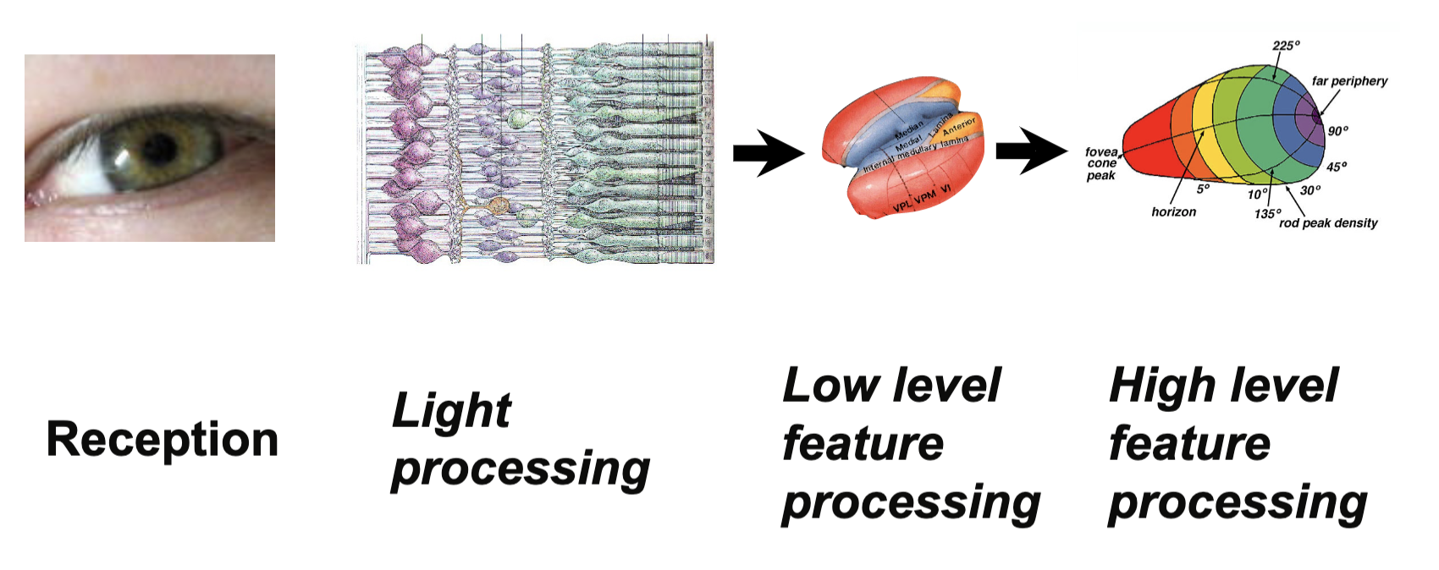
The neocognitron
Visual pattern recognition with performance similar to a human
Using the brain as inspiration →
Core idea of the neocognitron:
A hierarchical multilayered network consisting of neuron-like cells. Connections between cells are variable and the network is able to recognize patterns by learning.

Slide 22
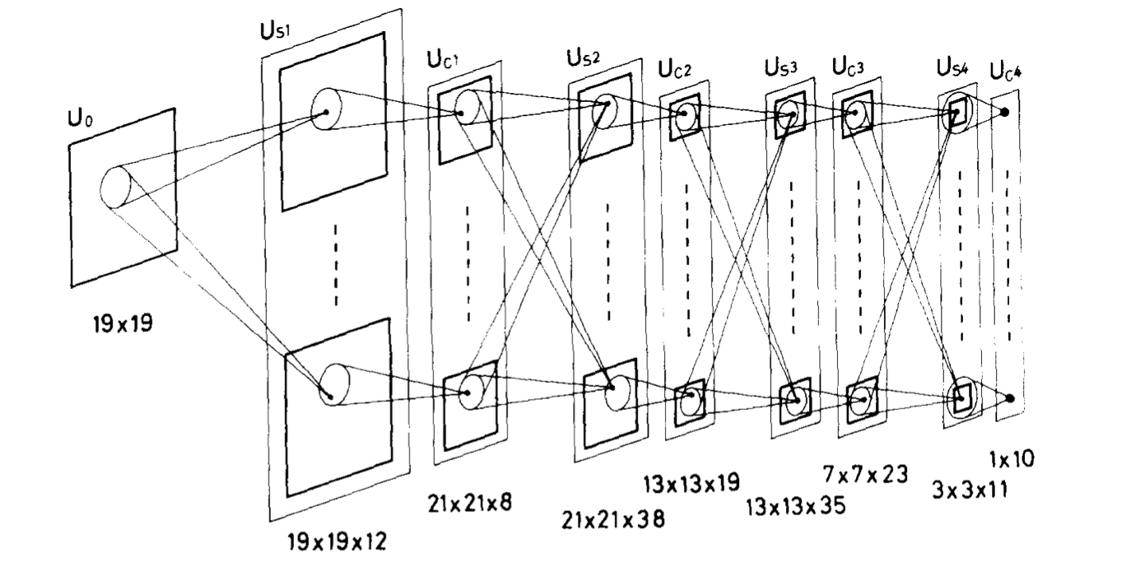
Structure of the model
Multiple layers
Alternating layers of S and C cells
Retinotopically ordered
Lower stage layers respond to low level features such as edges
Higher stage layers respond to more global features
As features detected become more global, neurons per layer decrease

Slide 23
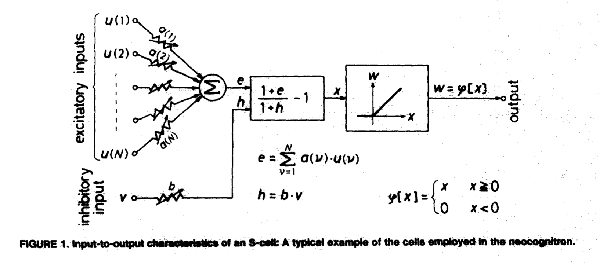
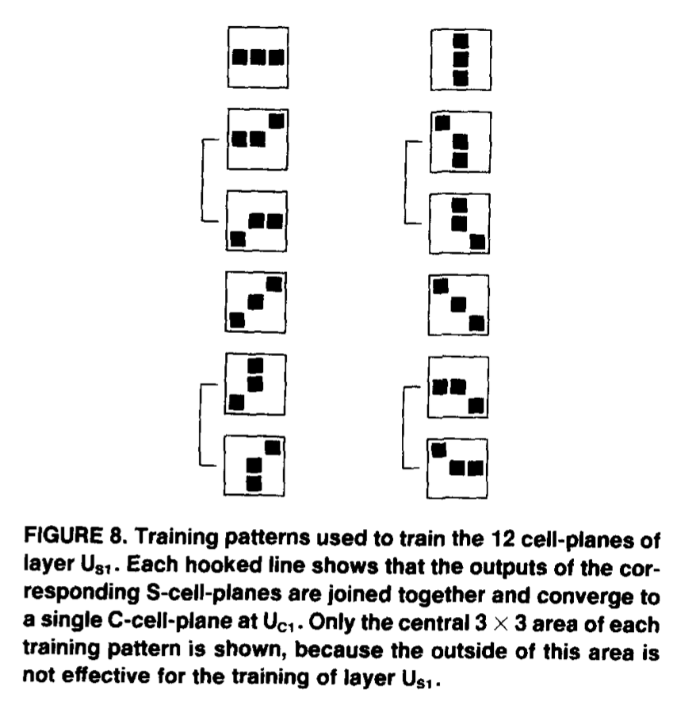
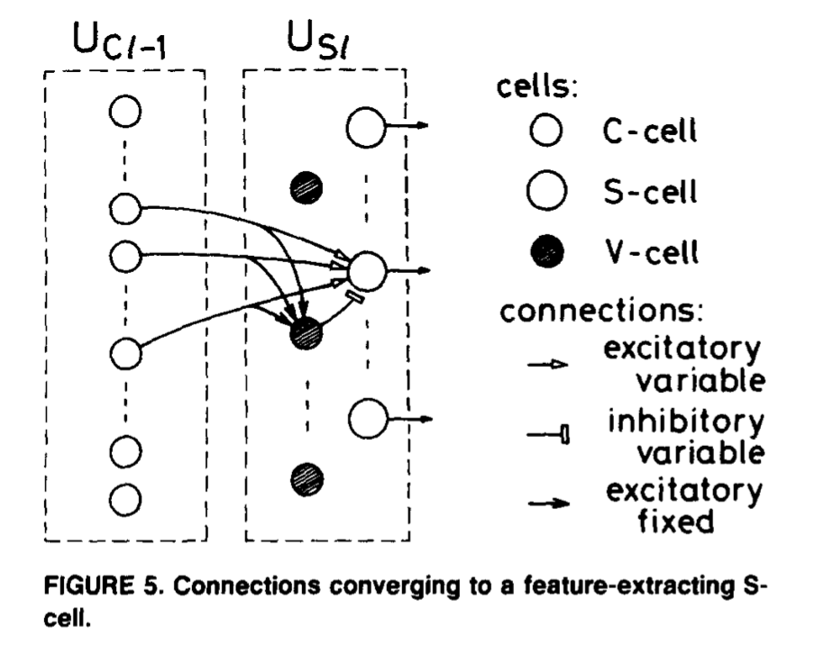
Types of Cells
Multiple types of cells
S Cells
Feature extraction
Variable weights
Similar to filters in convolutions and receptive fields.
C Cells
Combines output of S Cells which detect the same feature, but from different positions.
Constant weights
V Cells
Inhibitory
Detect irrelevancies

Slide 24
Self-organization
Variable connections reinforced if two conditions are true:
Receiving cell responds the strongest
Sending cell is also responding
Excitatory and inhibitory connections are reinforced
Result: connections to maximum-output S-cell grow
Matches spatial distribution of response cells
Acquires ability to extract features
'Winner takes all' and 'division of labor'

Slide 25
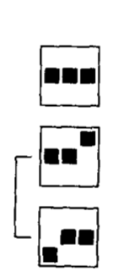
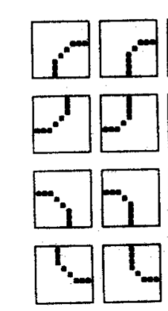
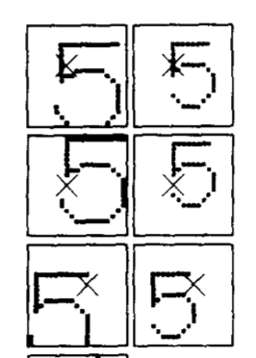
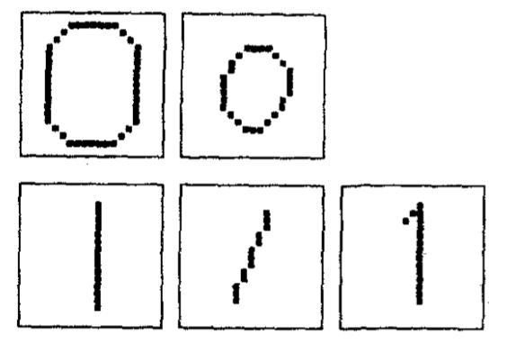
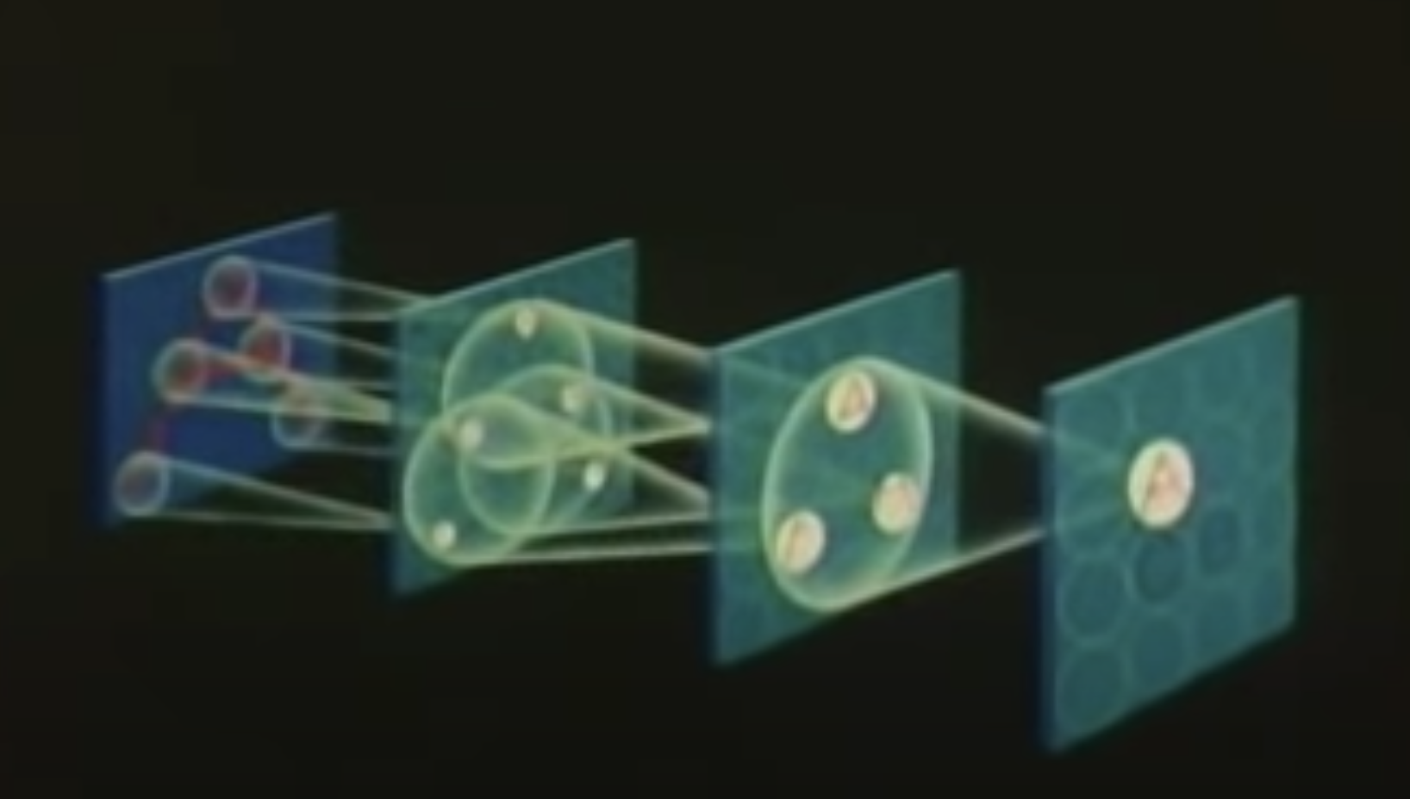
Training of the network
Lower stages to higher stages
Extract line components of different line orientations
More than one training pattern
To be able to recognize deformed patterns
Receptive fields become larger in higher stages
Cells are not affected by shifts in position in higher stages

Slide 26
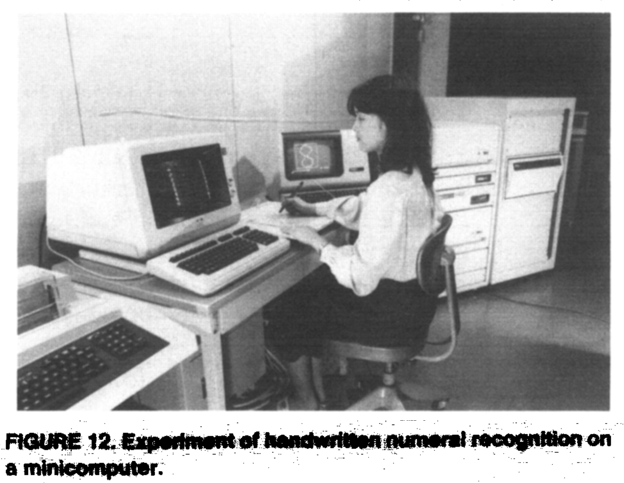

Slide 27
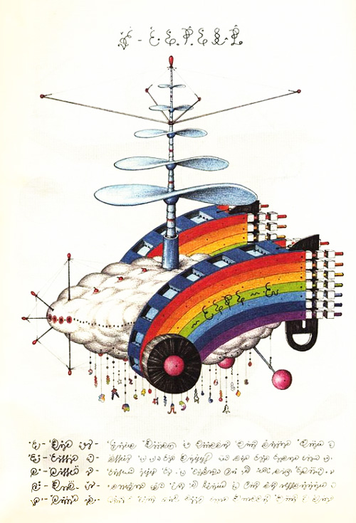
Acknowledgement: Codex Seraphinianus
Notes:
Just an idea: create a little awareness of how this works in our brains. Reason why I picked this image is because it is highly likely that nobody has a grandmother cell for this creation, so we’re all kinda stuck in the middle. (There’d be no point in picking a picture of Tom Cruise because everyone will recognize his face before we can even start talking). Anyways, according to the CNN idea your brains are processing this image a bit in the following way:
We already see lines, colours and shapes, without even being aware of it.
From the coloured shapes that we recognize, we can derive some basic structure elements. For instance we recognize a wheel, a rainbow, a cloud and an antenna of some sorts
But this is the point where we’re stuck. We can try to obtain more information on what its functions at least are. For instance there appears to be a rudder at the back of the rainbows and it seems to have some structure elements.
The point is, we cannot really proceed in analyzing this thing because it’s simply too alien. But if your brain recognized it - say you grew up in a world where these things exist - it would have been trained to call it by its name as quickly as you and I can call a car a car.
And essentially, any convolutional network does this. It takes small features from vision, combines elements step by step until it can be categorized, and will learn to categorize objects in more or less detail the more or less often it observes this object - or anything like it.

